Slide 1
Milestone 5 By Cianna Grummer SmartStride

Slide 2
Milestone 5
Task | Progress | To Do
Define sections | 100% | N/A
Create pie chart | 100% | N/A
New page for past results | 100% | N/A
Create API and Lambda functionalities for pie charts | 100% | N/A
Create API and Lambda functionalities for past results page | 100% | N/A

Slide 3
Define Graphs
Changes made:
Renamed EMG Analysis to "Gastrocnemius EMG Activity"
Remove "Gait Analysis with step classification" section
Pie Chart will go under "Monthly Session Details"
Put average ITW foot angle under "Last PT Session Details" (doctor)
The time series plot showing averages over 1 gait cycle for ITW vs Normal Step (x = time, y = angle (degrees)) (doctor)

Slide 4
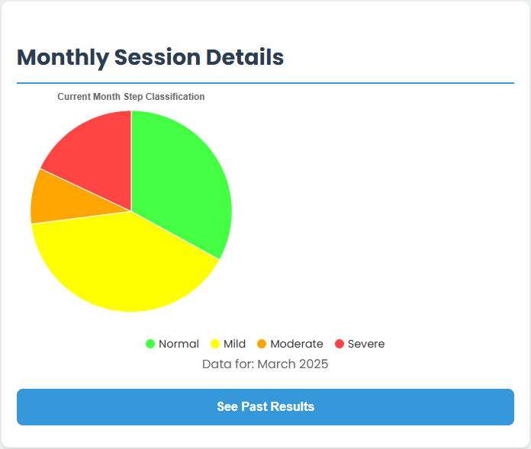
Pie Chart & Database
Pie Chart is visible to patient and doctors
Created new table in database
Patient_pie_data
Created GetPieData Lambda & API
Percentage of steps with classification
Normal, Mild, Moderate, Severe

Slide 5
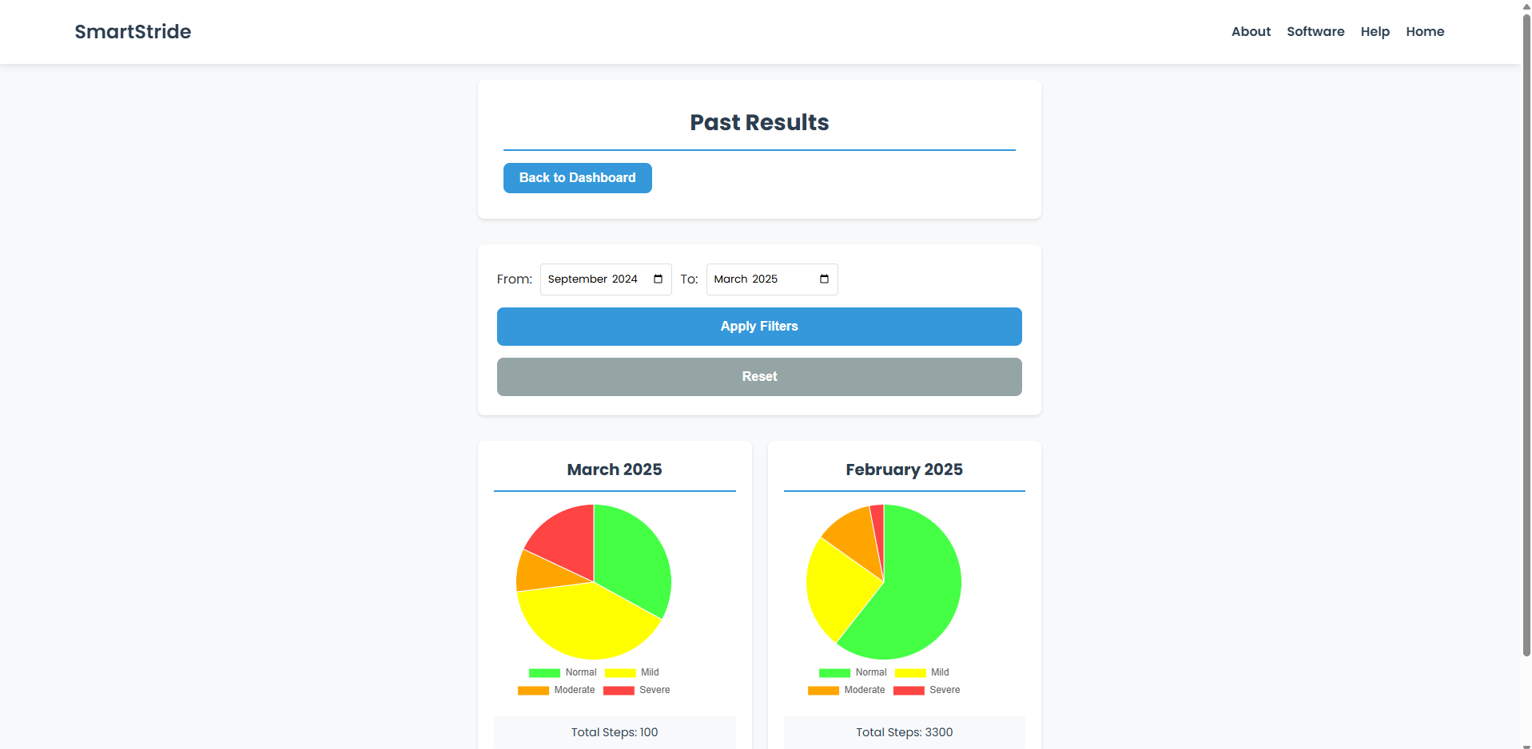
Past Results Page
Accessible through “See Past Results” button under the main page pie chart
Initially shows all patient results
Can filter by month and year
Uses the same API/Lambda as main page pie chart

Slide 6
Milestone 6
Task | Progress | To Do
User and/or Developer Manual | 0% | Create user and/or dev manual
Demo Video | 0% | Start creating a demo video
SmartStride Poster | 10% | Complete my section in the SmartStride poster
Update User Guide | 50% | Talk to SmartStride team to create a user guide for device
Update About Us Page & Home Page Description | 30% | Work with SmartStride to create a more accurate description
System Testing & Evaluation | 15% | Create a user survey, find testers, conduct login and data testing

Slide 7
User and Developer Manual
User Manual
Two user types patient and clinician
Shared sections: Sign-up, Log-in, Device Guide
Patient sections: Raspberry Pi app guide, manual upload, reading pie charts and severity bar
Clinician sections: Adding/dropping patients, viewing patient data, editing patient goals
Developer Manual:
Diagrams and explanations of website structure, database structure, AWS tools (API, RDS, CloudWatch etc.)
How to guide for accessing the database using VCP security groups

Slide 8
Demo Video
Will show key website features:
Sign-up and Log-in
Uploading data
Patient & clinician dashboards
Past results with filters
Raspberry Pi app
Real time updates when uploading data

Slide 9
Updating User Guide, About Us, and Home Page Descriptions
User Guide Page:
Currently has minimal information
Will include:
SmartStride device instructions
Raspberry Pi app instructions
User manual for patients and clinicians
About us page and home page
Rewrite to better describe the SmartStride device and website
What it is used for
Why it was made

Slide 10
System Testing & Evaluation
Three evaluation categories:
Usability
User survey to be completed after completing number of tasks
"How easy was it to find the sign-up page?" (1-5 stars)
One open ended feedback section
Reliability
Test data upload and login success rates
Data upload: 99% ideal, 95%-98% acceptable, <95% needs improvement
Login success rate: 99% ideal, 90%-98% acceptable, <90% unacceptable
Accuracy
Compare data uploaded to original data
Get success rate from comparing number of uploads to number of uploads where data matches

Slide 11
Questions?

